Slide 1
A theta(logn)-approximation for the set cover problem with set ownership
Mira Gonen , Yuval Shavitt
Information Processing Letters 109 (2009) 183–186
Presenter : Chih-Ying Lin
Date : Apr. 22, 2009

Slide 2
A b s t r a c t
In highly distributed Internet measurement systems distributed agents periodically measure the Internet using a tool called traceroute, which discovers a path in the network graph. Each agent performs many traceroute measurements to a set of destinations in the network, and thus reveals a portion of the Internet graph as it is seen from the agent locations. In every period we need to check whether previously discovered edges still exist in this period, a process termed validation. To this end we maintain a database of all the different measurements performed by each agent. Our aim is to be able to validate the existence of all previously discovered edges in the minimum possible time. In this work we formulate the validation problem as a generalization of the well know set cover problem. We reduce the set cover problem to the validation problem, thus proving that the validation problem is NP-hard. We present a O(logn)-approximation algorithm to the validation problem, where n in the number of edges that need to be validated. We also show that unless P = NP the approximation ratio of the validation problem is Ω(logn).

Slide 3
Problem Validation Set Cover (VSC).
Given a universe U of n elements, a collection of subsets of U, S = {S₁, . . . , S_{k}}, a partition of S π = {A₁, . . . , A_{m}} where A_{i} ⊆ S, and a weight function ω:π →N, find a subcollection S’ of S that covers all elements of U such that max_{1≤i≤m} |Ai ∩ S’|/ω(A_{i}) is minimum.

Slide 4
Example
U = {n₁,n₂,…,n₉}
S = {s₁,s₂,…,s₆}
s₁ = {n₂,n₃,n₆} s₂ = {n₂,n₃,n_{4,}n₇}
s₃ = {n₁,n₄,n₇} s₄ = {n₁,n₃,n₄,n₆,n₈}
s₅ = {n₃,n₅,n₈} s₆ = {n₄,n₆,n₉}
A = {a₁,a₂,a₃}
a₁ = {s₁} a₂ = {s₂,s₃,s₄} a₃ = {s₅,s₆}

Slide 5
Algorithm
s₁ = {n₂,n₃,n₆} s₂ = {n₂,n₃,n₄,n₇}
s₃ = {n₁,n₄,n₇} s₄ = {n₁,n₃,n₄,n₆,n₈}
s₅ = {n₃,n₅,n₈} s₆ = {n₄,n₆,n₉}
Stage 1
a₁ = {s₁} c = {n₂,n₃,n₆}
a₂ = {s₂,s₃,s₄} c = {n₁,n₂,n₃,n₄,n₆, n₇,n₈}
a₃ = {s₅,s₆} c = {n₁,n₂,n₃,n₄,n₅,n₆,n₇,n₈}
Stage 2
a₃ = {s₅,s₆} c = {n₁,n₂,n₃,n₄,n₅,n₆,n₇,n₈,n₉}

Slide 6
Claim 3.1. At step k≥1 of Algorithm at least n_{k−1}/opt_{k−1} elements in U are covered.
Proof. The main observation is that any optimal algorithm covers all the elements in opt stages. Obviously, there exists a stage in which at least n/OPT elements are covered.
Since the order of the stages does not change opt, assume without loss of generality that at stage 1 any optimal algorithm covers at least n/OPT elements.
Thus, if k =1 then, since Algorithm picks a set that covers the maximum number of elements, it holds that at least n/OPT = n_{k−1}/opt_{k−1} elements are covered at step k.
If k > 1 then an optimal algorithm covers all the n−1 remaining elements of U \ C_{k−1} in opt _{k−1} steps. Since Algorithm picks a set that covers the maximum number of remaining elements, it holds that at least n_{k−1}/opt_{k−1} elements are covered at step .

Slide 7
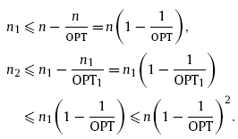
Lemma n_{k} ≤ n(1 −1/OPT)^{k}
Using the above claim and the observation that for all opt_{k} ≤ OPT

Slide 8
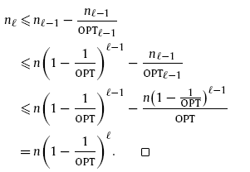
Lemma n_{l} ≤ n(1 −1/opt)^{l}

Slide 9


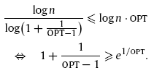
Theorem Algorithm gives an approximation ratio of O(logn).
n_{k} ≤ 1

Slide 10

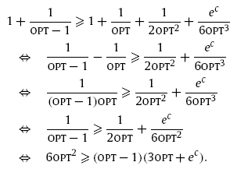
Theorem Algorithm gives an approximation ratio of O(logn).
According to the Taylor series we have that
for 0 ≤ c ≤ 1/OPT

